Slide 1
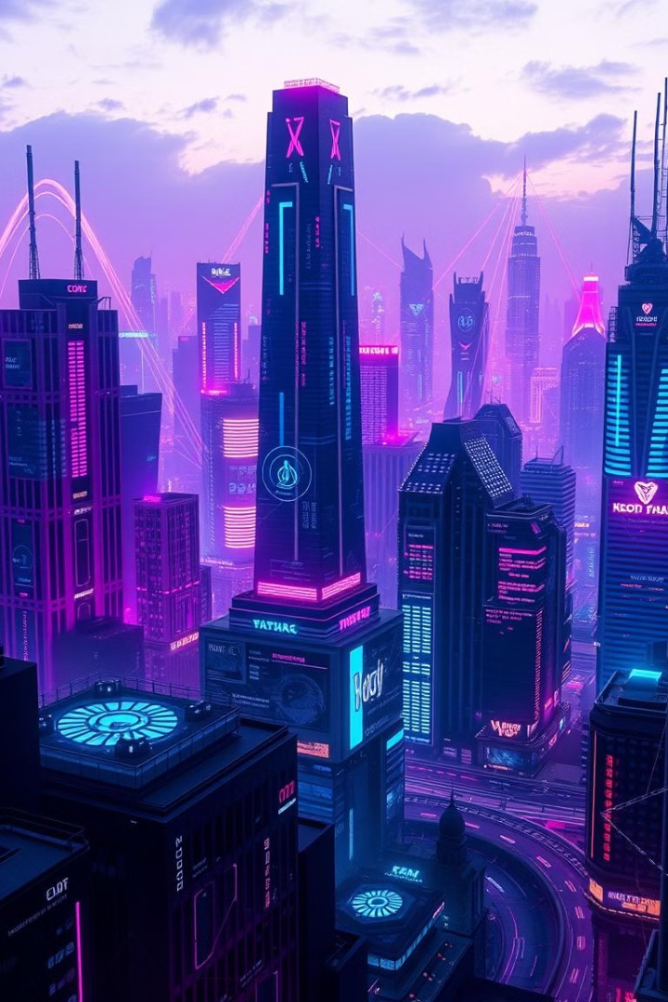
Exploring Augmented Reality and Virtual Reality
Augmented Reality (AR) and Virtual Reality (VR) are rapidly changing how we interact with the world. These technologies are blurring the lines between physical and digital reality.

Slide 2
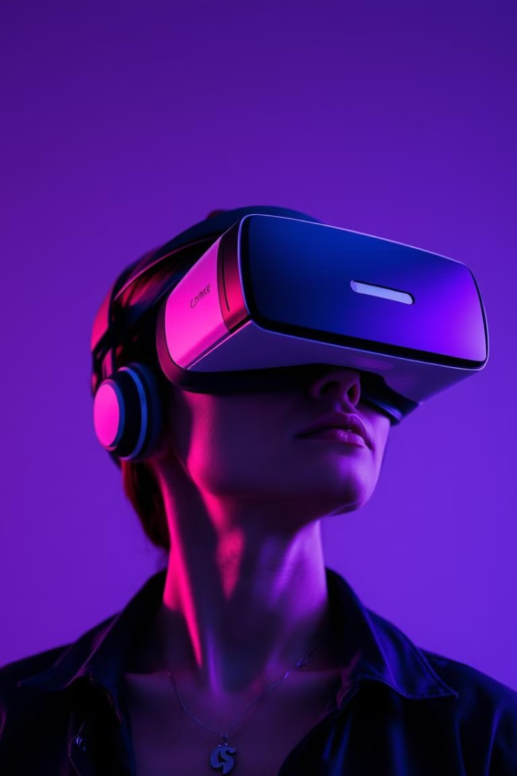
What is AR and VR?
Augmented Reality (AR)
Virtual Reality (VR)
AR overlays digital information onto the real world, enhancing our perception. Examples include Pokemon Go and Snapchat filters.
VR immerses users in a completely digital environment, creating a sense of presence. Examples include VR games and training simulations.

Slide 3
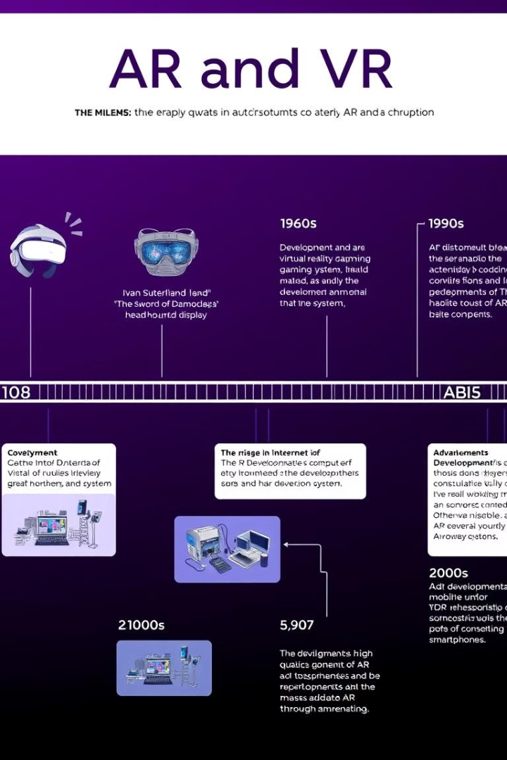
The history and evolution of immersive technologies
1
Early Concepts (1950s-1960s)
Introduction of Sensorama an arcade-style machine designed to provide immersive experience through a combination 3D film.
2
Birth of VR (1970s-1980s)
Ivan Sutherland’s Sword of Damocles the first head-mounted display by the development of computer graphics and early VR systems,.
3
Commercialization and Advancements (1990s-Present)
Advancements in technology, including higher resolution displays, improved motion tracking, and haptic feedback, have created more immersive and user-friendly experiences.

Slide 4
Applications of AR and VR across industries
Gaming and Entertainment
Healthcare
Education
VR games offer immersive experiences, while AR games blend the real and virtual worlds. AR is also used in theme parks and attractions.
VR is used for training surgeons, treating phobias, and managing pain. AR can assist with diagnosis and surgery.
AR and VR provide interactive learning experiences, allowing students to explore historical sites, dissect virtual organs, or practice skills in simulated environments.

Slide 5
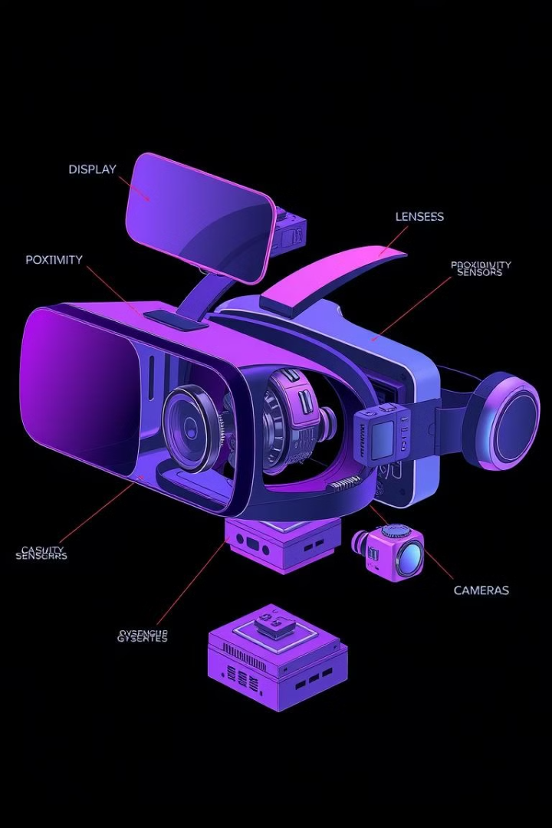
The hardware and software powering AR and VR
Hardware
Software
Head-Mounted Displays
Motion Tracking Systems
Game Engines(Unity , Unreal)
Content Creation Tools
Input Devices
Audio Systems
Development Kits
(e.g., ARKit, ARCore)

Slide 6

Challenges and limitations of current AR and VR systems
Motion Sickness
High Cost & Privacy Issue
Limited Content Availability
1
Extend use can cause discomfort, with issue like motion sickness is common in VR.
2
VR headsets and AR devices can be expensive, limiting accessibility for many consumers and businesses.
Many AR and VR systems require extensive data collection, raising concerns about user privacy and data security.
3
The availability of high-quality and engaging AR and VR content is still limited,which require time and skills.

Slide 7
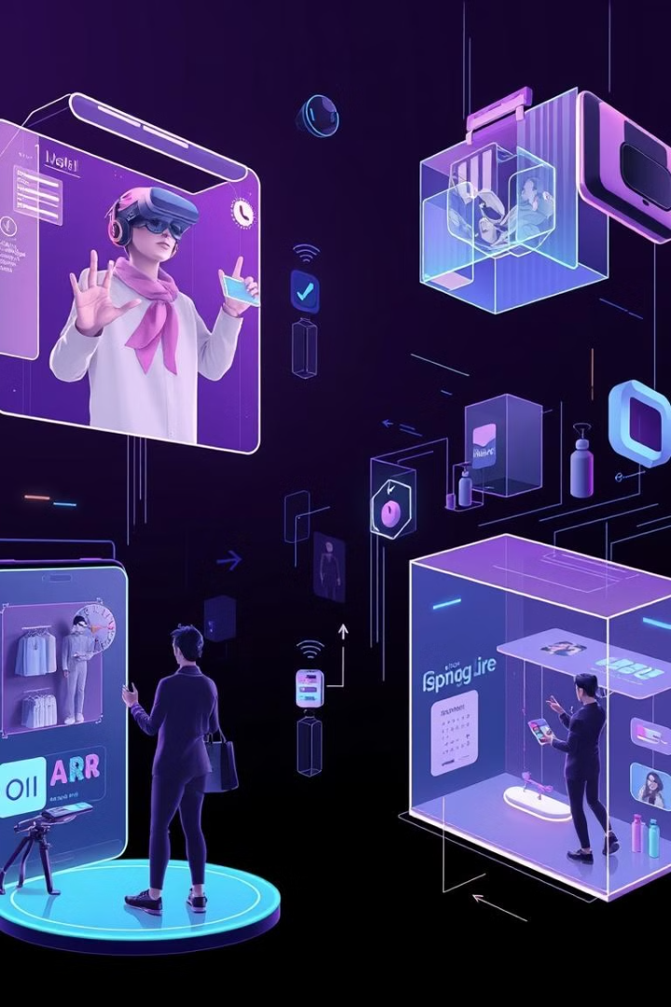



The future of AR and VR: Trends and innovations
Improved Hardware
Advances in materials will lead to lighter, more comfortable headsets with better ergonomics , Improved GPUs and displays will offer higher resolutions and refresh rates, enhancing immersion.
Enhanced Content
Content can include interactive features that allow users to manipulate objects, solve puzzles, or engage in storytelling, creating a more participatory experience.
Integration with AI
The integration of AI will enable more personalized, responsive, and intelligent AR and VR experiences.

Slide 8
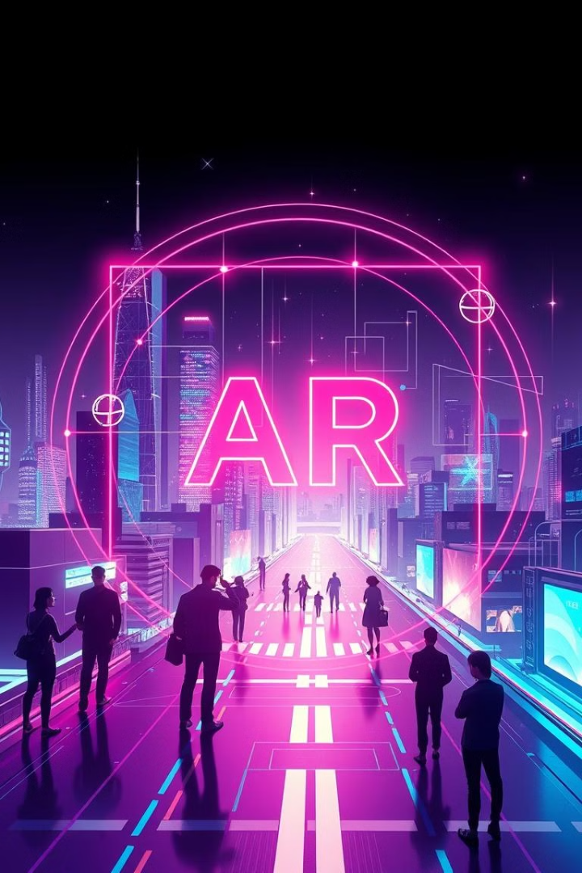
Conclusion and key takeaways
In summary, AR and VR technologies are quickly advancing and have the power to transform various industries. By tackling current challenges and encouraging innovation, we can create a future where these technologies become a natural part of our lives. This will enhance our experiences and change the way we interact with the world, opening up exciting possibilities for learning, work, and entertainment.

